Slide 1

Team 11 – vinyl record and book classifier
Project 3: Mark wireman
April 10, 2025

Slide 2

Problem statement
With a growing collection of books and vinyl albums it is a challenge to keep track of what I have, the details of the item, and current value.
Alas, a solution to the problem has been found! What a better way to use my newly acquired knowledge to begin a journey along the AI deep learning path to assist me in creating an inventory of my collection.
The first step is to take my idea and build an….

Slide 3






Image Classification overview
AGENTIC AI SYSTEM
Download images
Train the model
Uses the DuckDuckGo Python library to download random images of books and vinyl records.
Designed to train and validate a deep learning model using either MobileNetV2 or ResNet50 as the base model, XLA or Adam optimization
Preprocess images
Predict the category
Perform a cleaning of the images using the TensorFlow and PIC libraries to convert or remove problem images, if required.
The model is intended to classify images into two categories: vinyl records and books.
Choose the parameters
View results
A Flask application to allow the user to configure the agents and select what agents to run.
A built-in system to view progress in real-time and visualize the results.
Notes:
XLA (Accelerated Linear Algebra) is a domain-specific compiler for linear algebra operations that optimizes TensorFlow computations.
XLA analyzes and optimizes TensorFlow operations at runtime, converting them into highly efficient machine code specifically for the GPU hardware (can also support Next Gen CPUs [i3+] with multiple cores).
XLA combines multiple small operations into larger, more efficient kernels

Slide 4

Key features
Model Selection: The code allows users to choose between MobileNetV2 and ResNet50 as the base model.
Custom Preprocessing Layer: A custom preprocessing layer is implemented to handle image preprocessing for both MobileNetV2 and ResNet50.GPU
Optimization: The code is optimized for GPU usage with shared memory optimization and auto-clustering enabled.
XLA Compilation: The code uses XLA (Accelerated Linear Algebra) compilation to optimize computations.
K-Fold Cross-Validation: The code implements K-Fold cross-validation to evaluate the model's performance.
Data Augmentation: The code applies data augmentation techniques to the training data.
Model Evaluation: The code evaluates the model's performance using metrics such as accuracy, precision, and recall.

Slide 5

Performance and benchmarking features
Let the agents do the work!

Slide 6
Automated Performance and Benchmarking
GPU Performance Benchmarking: The code includes a benchmarking function to measure the performance of the GPU with different batch sizes.
Batch Size Optimization: The code adjusts the batch size based on the GPU's performance to optimize shared memory utilization.
Speedup Calculation: The code calculates the speedup achieved by using batch processing with different batch sizes.
Custom Preprocessing Layer: A custom preprocessing layer to handle image preprocessing
Global Average Pooling Layer: A global average pooling layer to reduce the spatial dimensions of the feature maps
Dense Layers: One or more dense layers with ReLU activation and dropout
Final Classification Layer: A final classification layer with softmax activation

Slide 7
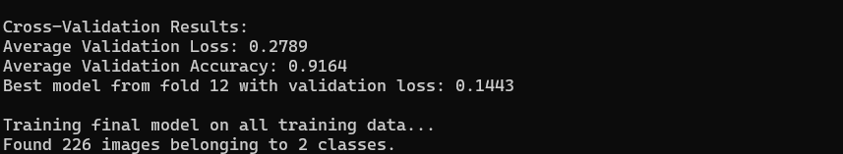
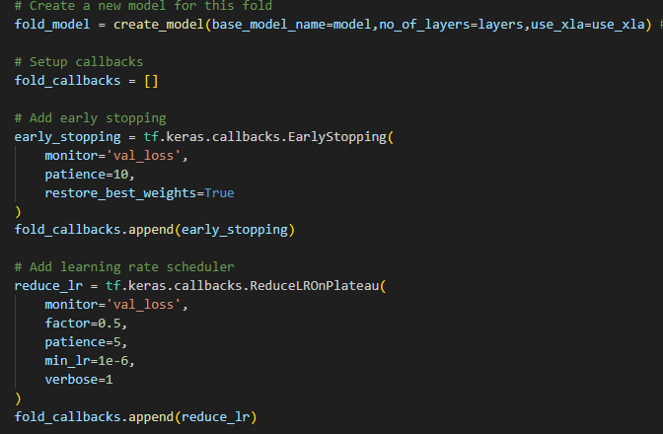
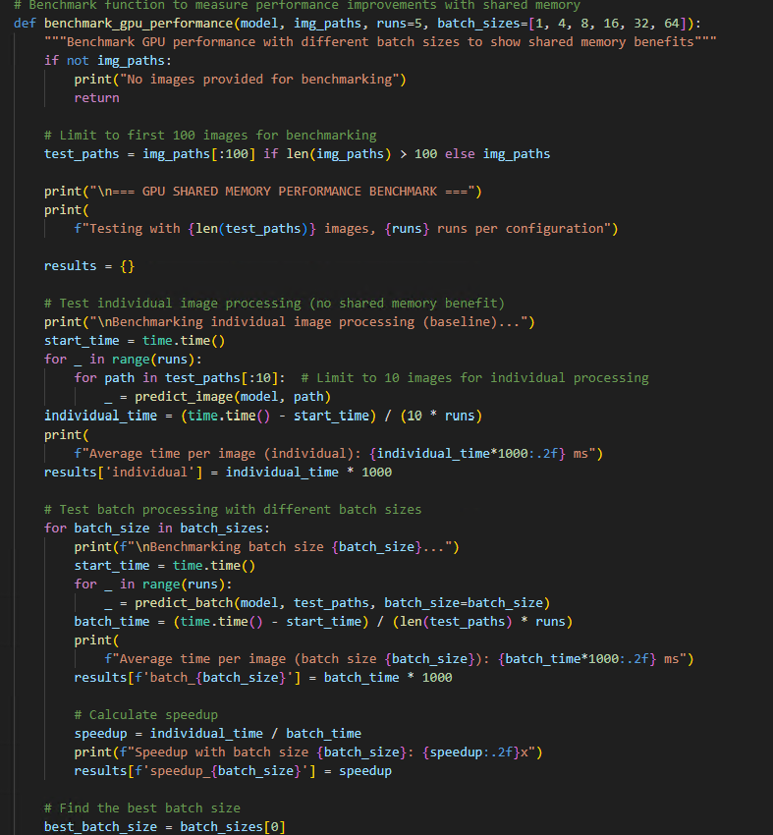
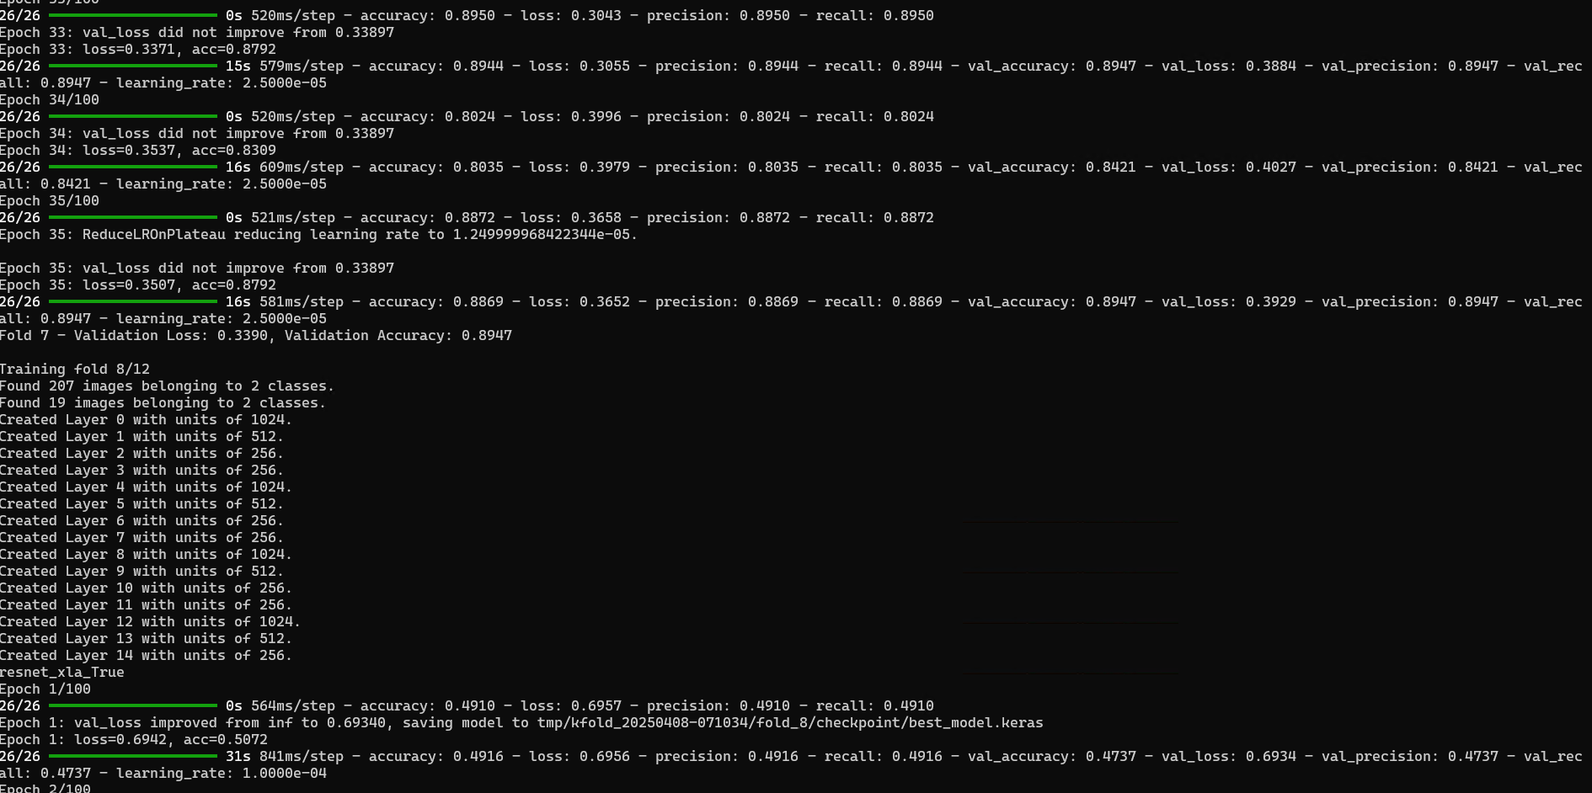
automated performance and benchmarking
Metrics from folds used to determine “best model” to use
Configuring each fold for early stopping and learning rate
Use GPU to calculate best batch size to use
ReduceLROnPlateau callback monitors validation loss and the training uses other metrics to improve model performance and validation.
K-Fold cross-validation to evaluate the model's performance and automated assignment of units to the layers to improve the deep learning with the training set
Notes:
ReduceLROnPlateau is a callback in TensorFlow/Keras that monitors a specified metric (usually validation loss) and reduces the learning rate when that metric stops improving.

Slide 8
usage
configurations

Slide 9
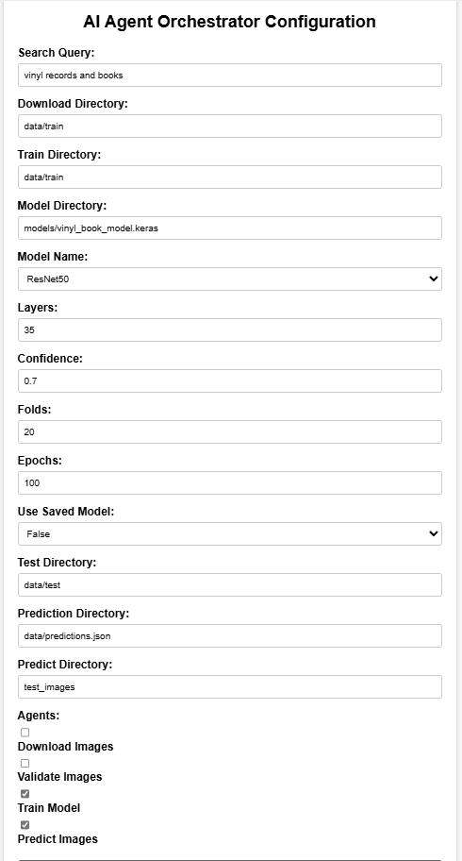
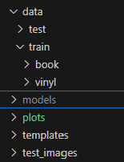
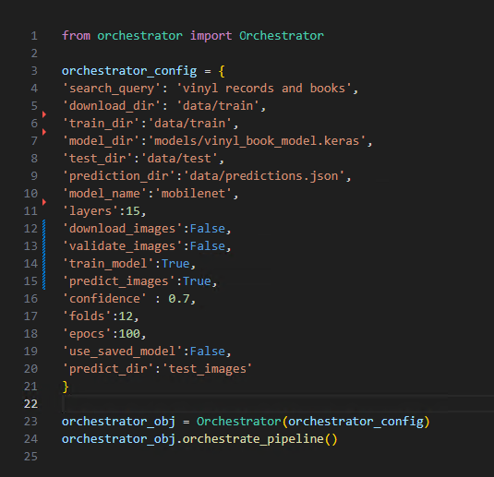
User interface and cli configuration settings
Random images to download
Created by the application
Directory to save images
Directory of images to use for training
Directory location and name of trained model
Pre-trained model to use for training the custom image classification
Number of training layers per fold
Confidence to use for prediction
NOTE: If cloning, the code will run with the default settings
Number of K-folds to use
Number of epochs per layer
CLI: test_orchestrator.py
Use the saved model for prediction – otherwise a new model will be trained
If any additional testing is required, put directory here
Directory location and name of prediction results
Directory where the images to predict/classify are stored
Select Agents to run:
Download – uses the Download Directory
Validate – uses the Download Directory
Train – uses the Model Directory, Train Directory, Model Name, Layers, Confidence, Folds, and Epochs
Predict – uses the Model Directory, Prediction Directory, and Predict Directory

Slide 10
demo
Ui and cli

Slide 11
The future
Backlog of enhancements

Slide 12

Future enhancements
Allow user to enter a learning rate
Allow user to enter a patience value
Allow user to enter the number of training images to fetch
Create a CSV or database inventory of the predicted images
Refactor the code to reduce code complexity and support dynamic classes
Use a GUID to align output with model runs
Improve the async messaging by using Kafka or Redis
Bug fixes

Slide 13

GITHUB REPOSITORY

Slide 14


QUESTIONS

